Slide 1
VISITATION:
The Heart and Art of the Matter

Slide 2
VISITATION:
The Heart and Art of the Matter
Visitation is a very vital part of successful evangelism. It is well nigh impossible, except under special divine intervention, to win those with whom we do not have a relationship.
In addition, there are families who will never hear the good news of the gospel and understand what it means to serve God faithfully, unless you as Christ’s representative enter their homes and open to them the love of God.
If we are to fulfill the Great Commission, “It should be accomplished mainly through persevering efforts visiting people in their homes.” (Thoughts from the Mount of Blessing, p102)

Slide 3
VISITATION:
The Heart and Art of the Matter
Ellen White writes:
We should not wait until people come to us; we should seek them where they are. (ibid 82)
Many are waiting to be personally addressed, Desire of Ages, 141.

Slide 4
Bible examples
Jesus
Our Saviour went from house to house, healing the sick, comforting the mourners, soothing the afflicted, speaking peace to the disconsolate. Christian Service, p. 114.

Slide 5
Bible examples
The disciples
Mark 6:7
“And he called unto him the twelve, and began to send them forth by two and two; and gave them power over unclean spirits”
Luke 10:1
“After these things the Lord appointed other seventy also, and sent them two and two before his face into every city and place, whither he himself would come.”

Slide 6
Bible examples
The Early Church
Acts 5:42
“And daily in the temple, and in every house, they ceased not to teach and preach Jesus Christ.”
Acts 20:20
“And how I kept back nothing that was profitable unto you, but have shewed you, and have taught you publicly, and from house to house.”

Slide 7
Why should we visit?

Slide 8
We visit to develop Christian friendship
Surveys indicate that about 70 to 80 percent of those baptized in the church had their first contact through a relative, a friend or an Adventist
neighbour. This proves that for the most part people are won to the church through friendship.
Our fast-pace, high-tech society has left many people lonely. These people are eager, and will respond positively to genuine Christian friendship.
Ellen White counsels: “Your success does not depend so much on your knowledge and talent, as from your ability to win hearts.

Slide 9
We visit to find and help people who are in need
We visit to listen, and to minister to the needs of people.
Isaiah 58:6-8:
“Is not this the fast that I have chosen? To loosen the bands of wickedness, to undo the heavy burdens, and to let the oppressed go free, and that ye break every yoke? Is it not to deal thy bread to the hungry, and that thou bring the poor that are cast out to thy house? When thou seest the naked, that thou cover him; and that thou hide not thyself from thine own flesh? Then shall thy light break forth as the morning, and thine health shall spring forth speedily: and thy righteousness shall go before thee; the glory of the LORD shall be thy reward.”
As Christians, God expects us to minister to those who are without hope and inspire those who are despondent.

Slide 10
We visit to share our testimonies
We visit to share our personal testimony of God’s leading in our lives and to share Christ as the only answer for the problems in our world
We visit to share the joy and happiness that exist in the life of a Christian
“Let your light so shine before men that they may see your good work, and glorify your Father which is in heaven,” (Matthew 5:16).
“We need to sing, to pray and give Bible studies in the homes.” Christian Service, p. 144.

Slide 11
We visit to give Bible studies
“Hundreds and thousands were seen visiting families, and opening before them the Word of God. Hearts were convicted by the power of the Holy Spirit, and a spirit of genuine conversion was manifest.” ibid, p. 42.

Slide 12
Who should we Visit?

Slide 13
We should visit our neighbors, friends and relatives
Mark 5:18-20 (NKJV)
“And when He got into the boat, he who had been demon-possessed begged Him that he might be with Him. However, Jesus did not permit him, but said to him, "Go home to your friends, and tell them what great things the Lord has done for you, and how He has had compassion on you."
“Go to your neighbours one by one, and come close to them till their hearts are warmed by your unselfish interest and love.” ibid, p. 116
“Wherever a church is established, all the members should engage actively in missionary work. They should visit every family in the neighbourhood. ibid p. 12.
“If they refuse to work on behalf of their unconverted neighbours, they will be called to account for their unaccomplished duties. Thoughts from the Mount of Blessing p 94

Slide 14
We visit to meet and work with persons who are attracted by the diverse evangelistic activities of the church
Small groups
Sabbath School
Bible Classes
Radio and TV programmes aired by the church
Evangelistic campaigns
Ingathering contacts
Bible correspondence school contacts
Non members and relatives of those who attend our schools
Colporteur work contacts
Persons who indicate their interest in receiving Bible study, through surveys conducted by the church
The Interest Coordinator and Personal Ministries Leader should have a list of all the names and addresses of these persons

Slide 15
How to Prepare for the Visit

Slide 16
How to Prepare for the Visit
Organize the members into groups of two
The Bible plan of visiting two by two is very effective
Husband and wife make a good team for visitation
Where possible, place an experienced person with a less experienced person
Prepare a list of the persons to be visited
Meet and have intercessory prayers for those to be visited
Select and mark some Bible passages to be shared with those to be visited

Slide 17
How to act when Visiting Interested Persons

Slide 18
How to act when Visiting Interested Persons
Have a good appearance and maintain a happy face
Show interest for all members of the family
Manifest sympathy, attention, kindness and love to the family members
Remember that before you can win persons to Christ, you must first gain their friendship and trust
Manifest enthusiasm and conviction
Do not criticize other denominations

Slide 19
How to act when Visiting Interested Persons
Do not enter into an argument or dispute with those you are visiting
Do not be insistent
Do not ask indiscreet questions
Do not talk too much
Do not visit persons of the opposite sex alone
Visit at suitably, mutually, agreed time and be punctual

Slide 20
What to do during the Visit
When you arrive, greet everyone
“Much depend on the manner in which you deal with those you visit. When greeting somebody, you can shake his hand in a way that you will his trust, or in such a cold way that will make him think that he is not important to you.” ibid p. 94
Introduce the person who accompanies you
Talk in a friendly way in order to create a favourable environment
Do not monopolize the conversation, but listen to others with attention and patience
Always look at the person with whom you are speaking
Demonstrate sincere interest in those you are visiting
Try to find out the occupation of the head of the family and the denomination to which he belongs
Try to know the names of all the family members

Slide 21
What to do during the Visit
Share your personal testimony and some Bible promises. These will open their hearts
Pray with and for the family
Invite the family to participate in the Bible study, by finding Scripture passages and asking relevant questions
Pray to close the study, and ask God to give everyone the strength to live by what they have just learnt
Set the date for the next meeting
Say goodbye to everyone
Leave

Slide 22
What to do in Difficult Situations
Some persons will be receptive to the gospel, while others will not. If persons react in an unfavourable way, always be cordial and maintain a Christian attitude
Where possible, always finish the visit with prayer, thus ending in a friendly way. This should always be the case when visiting the sick, the newly baptized, backsliders, and inactive members. back to Jesus and the church

Slide 23
What to do in Difficult Situations
Pray, console and encourage those who are sick
Integrate the newly baptized into the church community and help them to make friends with other church members
Demonstrate love and attention for backsliders and help them to heal their emotional wounds by listening to them and encouraging them to come back to Jesus and the church

Slide 24
What to do in Difficult Situations
Remember, while working to win others and thus contributing to the growth and spiritual nourishment of the church, be sure to feed your own soul through regular Bible study and prayer. Acts 3:6 “Then Peter said, Silver and gold have I none; but such as I have give I thee: In the name of Jesus Christ of Nazareth rise up and walk.” This verse outlines an important principle: we can only give what we have. One writer correctly states, “The power for holy service is intercourse with God.”
Remember also, “Angels of God will attend you to the dwellings of those you visit.” Christian Service, p. 118
“By visiting the people, talking, praying, sympathizing with them, you will win their hearts.” ibid, p. 118.

Slide 25
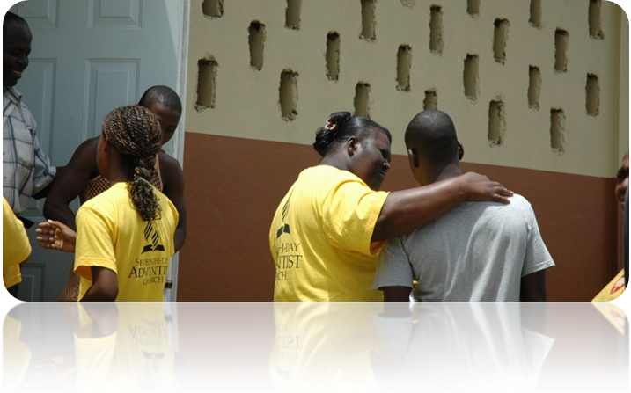
Adopted from Original document VISITATION by Inter American Division, 2002

