Slide 2
SMALL GROUPS
Key to Successful Evangelism & Nurturing

Slide 3
Small groups have always been a part of God’s plan for His church.
This fact is borne out by the following:
The establishment of the nation of Israel as God’s people
The establishment of the early church
The establishment of the Seventh Day Adventist church

Slide 4
The Nation of Israel
As the Israelites traveled from Egypt to Canaan Jethro advised Moses to organize the people into groups.
Exodus 18:21
“Moreover thou shalt provide out of all the people able men, such as fear God, men of truth, hating covetousness; and place such over them, to be rulers of thousands, and rulers of hundreds, rulers of fifties, and rulers of tens...”
Ellen White states:
“He (God) designs that we should learn lessons of order and organization from the perfect order instituted in the days of Moses.” Christian Service, p. 73

Slide 5
The Early Church
Jesus used a small group as the base for His ministry and the early church continued the practice.
Matthew 10:1
“And when he had called unto him his twelve disciples, he gave them power against unclean spirits, to cast them out, and to heal all manner of sickness and all manner of disease.”
Acts 5:42 (NIV)
“Day after day, in the temple courts and from house to house, they never stopped teaching and proclaiming the good news that Jesus is the Christ.”

Slide 6
The Seventh-day Adventist Church
The Seventh-day Adventist Church began with small groups. We are also counseled by the Spirit of Prophecy about the importance of this medium in sharing the gospel in the last days.
“Time is short, and our forces must be organized to do a large work.” ibid, p. 72
“The formation of small companies as a basis of Christian effort has been presented to me by One who cannot err.” Ibid, p. 72
“Hundreds and thousands were seen visiting families, and opening before them the word of God. Hearts were convicted by the power of the Holy Spirit, and a spirit of genuine conversion was manifest.” ibid, p. 42

Slide 7
Why should we organize small groups in our churches?

Slide 8
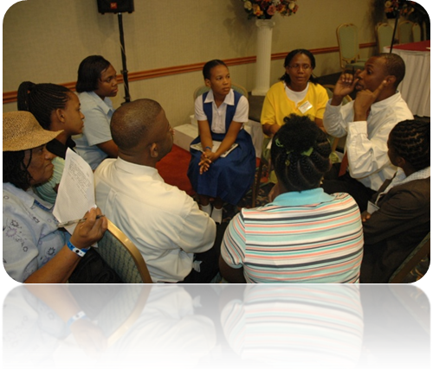
It is God’s plan
Luke 10:1
“After these things the Lord appointed other seventy also, and sent them two and two before his face into every city and place, whither he himself would come.”
Acts 2:42, 47
“And they continued steadfastly in the apostles' doctrine and fellowship, and In breaking of bread, and in prayers. Praising God, and having favour with all the people. And the Lord added to the church daily such as should be saved.”

Slide 9
It is God’s plan
“The formation of small groups as the basis of Christian efforts has been presented to Me by One who cannot err.” Christian Service, p. 72
“In our churches let companies be formed for service.” ibid, p. 72
“If there is a large number in the church, let the members be formed into small companies, to work not only for church members, but for unbelievers.”
“If in one place there are only two or three who know the truth, let them form themselves into a band of workers.”

Slide 10
What are the objectives of Small Groups?

Slide 11
What are the objectives of Small Groups?
Spiritual growth—achieved through the study of the Word, prayer, witnessing and fellowship.
Community Outreach—identifying and ministering to the needs of group members as well as those in the community.
Evangelism—building relationships as well as actively leading people to Christ
Testimonies, vol. 7, p. 22— “Let the members be formed into small companies, to work not only for church members, but for unbelievers.”

Slide 12
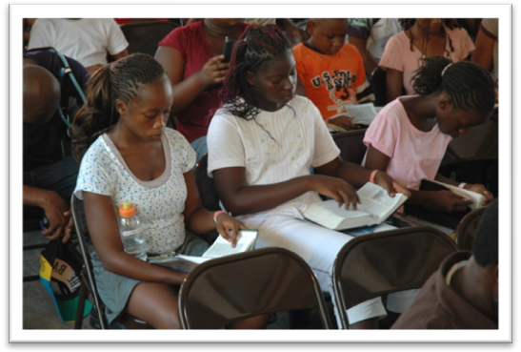
What are Small Groups, and how do they operate?

Slide 13
What are Small Groups, and how do they operate?
Small groups are weekly meetings of 3 – 12 persons who are interested in their personal spiritual growth as well as witnessing.
The meetings last approximately one hour each week.
The group members can be organized based on geographic location as well as affiliation with other members of the group.
The meetings can be conducted in a house, a garage, a cottage or anywhere that is convenient
Each group should have a leader and an associate leader

Slide 14
What are Small Groups, and how do they operate?
The members of the group are to decide the day, time and place of meeting.
Each group pledges to meet regularly for at least six months.
After the six months the group can make a re-commitment to continue for another time period.
The groups are to establish their goals for growth, with plans to create new groups.

Slide 15
Programme Guide

Slide 16
Programme Guide
The time frame given for each item is flexible, but the following is given to ensure order and adequate time for the study of the Scripture.
  Welcome & praise – 10 minutes
  Fellowship – 10 minutes (introduction of visitors & taking time to know each other)
  Testimonies – 15 minutes (members share something that has been a blessing to them or others, or an experience in witnessing. The leader also shares the plans for evangelism together with the group evaluate their activities to ensure that the goals are being achieved).

Slide 17
Programme Guide
  Bible study – 35 minutes (all members are to participate in the study, reading Bible passages, applying the message studied to their lives, and committing to implement and live what they have learnt).

Slide 18
How to Establish Small Groups in the Local Church

Slide 19
How to Establish Small Groups in the Local Church
The Church Pastor or First Elder calls the Church Board and prayerfully present the matter to the members.
The plan should not be imposed. The participation and involvement of the members in the small groups, is voluntary.
Help the leaders and members understand the programme.
Provide both leaders and members with relevant materials.
Establish pilot groups in each church. Don’t start everyone at the same time.

Slide 20
How to Establish Small Groups in the Local Church
The group leaders should be trained before the groups are established.
The small groups should not replace the Sabbath School Action Units, but the small groups can function as Sabbath School Action Units.
The structured study of the Bible is central to the small groups. Lessons and Bible study materials are provided by the church.
The interests from the small groups serve as the base for evangelistic campaigns.
Children are to be incorporated into the programme, and should help in finding and reading Scripture passages.

Slide 21
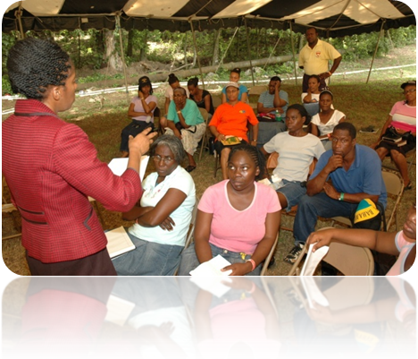
Necessary steps for implementing Small Groups in the Local Church

Slide 22
The Pastor’s Role
The Pastor should prepare himself by studying the Bible, the Spirit of Prophecy as well as other relevant materials on the subject.
The Pastor should convince himself that small groups contribute both to the spiritual development of the members as well as fulfilling the great commission, which includes both winning and nurturing new members.
The Pastor should then present the programme to the Elders and Church Board, and secure their support.
The Pastor should be the coordinator of the small group programme, or he should delegate responsibility to the personal ministries leader or an elder and ensure that the programme is effectively coordinated.

Slide 23
The Pastor’s Role
The Pastor or Small Group Coordinator, guided by the Church Board should select the Small Group leaders.
The leaders of the Small Groups constitute the Small Group of the Pastor or Small Group Coordinator. He meets with them at least once per month to get feedback, motivate train and equip them, so that they can successfully conduct their Small Group meetings in their communities.

Slide 24
Preparation of Leaders
To ensure the successful implementation of the small groups programme, and also to prevent persons to infiltrate the groups with their personal agendas, group leaders must be properly trained, and follow a structured curriculum. The training for Group Leaders should cover the following:
  Biblical principles of small groups
  The workings of small groups
  The historical background of small groups
  Small group leaders and their responsibilities
  Evangelism through small groups
  Small group & membership retention

Slide 25
The role of the Small Group leaders
Group leaders are to provide information to members regarding the responsibilities they are expected to bear
The leaders are to coordinate with the members the venue, date and time of the weekly meetings.
The leaders are to be prepared to attend bi-weekly meetings conducted by the Pastor or Coordinator to give reports and receive training and motivation

Slide 26
Preparation of Church
Study the plan with the Church Board and secure the approval of the members
If the Pastor is not the Coordinator, appoint the Personal Ministries Leader or an Elder as the Coordinator
Use the Personal Ministries Council to organize and execute the plan
Appoint the leaders for each group
Conduct a revival to prepare the church members for the programme
Present the plan to the church after the revival.

Slide 27
Preparation of Church
Invite interested church members to sign up to be a part of a group.
Convene a meeting with the group leaders and provide them with the necessary material and directions

Slide 28
Getting the group started
The Personal Ministries Secretary is to prepare a list of all the persons who signed up for the group, so that the leader may invite these members into his/her group.
The leaders choose the members of their small group.
Groups should be organized on the basis of affiliation or geographical location
No one should be forced into a group. Each person is free to decide which group he/she desires to be a part of.
Where possible, families should belong to the same group, except the youth want to create a special group only for themselves.

Slide 29
Getting the group started
The Church Clerk should make available a list with all members so that the group leaders may invite these members to join the groups most convenient to them
The Church Clerk should also prepare and make available to the leaders another list containing inactive members or backsliders so that the groups can work to win them back.
The group leader and the Coordinator should decide on the most suitable place to conduct the weekly meetings.

Slide 30
Conducting the meetings

Slide 31
Conducting the meetings
Call your first group meeting.
Have each member sign an agreement of participation
This agreement can be written or verbal
Each group can choose a name, a hymn as their theme song , a Bible text as their theme text and a banner
The group meetings should begin with a period of training which should last between four to eight weeks.
Only after the period of training should new prospects be invited to join the group.

Slide 32
Conducting the meetings
Persons to be invited into the small groups are:
  Parents
  Neighbours
  Friends
Persons who have been watching or listening to TV and radio programmes; persons who visit our churches, or parents of students who attend our schools; anyone interested in studying God’s Word
Every group should always have at least one empty chair and constantly urge its members to take a visitor with them.

Slide 33
Conducting the meetings
Every meeting should have a slot for intercessory prayer where the names and requests of interested persons are taken and prayed for.
Growth should be the goal of all small groups. When this occurs the group should then divide into two groups.
Each group should have the following missionary goals:
  Number of non-members you want to join the group
  Number of Bible studies you want to cover
  Plans for visitation which should include church members, prospective members, and shut-ins.
  Number of baptisms to be achieved within a given period.

Slide 34
Suggested activities for the first small group meeting
Reception and greeting by the group leader
Song service
Socialization and presentation of visitors
Confirmation of date, time and venue of meeting
Provide all necessary instructions to group members
Have each group member sign the personal commitment card.

Slide 35
Suggested activities for the first small group meeting
Provide names and addresses of church members to be visited or invited to the group meeting. Assign persons to visit these individuals and report to the group at the next meeting.
Bible Study
Closing prayer

Slide 36
Benefits of organizing the Church into small groups
It increases the study and understanding of God’s Word
It promotes spiritual growth
It enhances Christian fellowship among members
It provides a forum for meeting the needs of both members and non-members
It helps members identify their spiritual gifts and talents
It empowers members to utilize their spiritual gifts and talents in ministry

Slide 37
Benefits of organizing the Church into small groups
It assists the Pastor in ministering to his congregation
It reduces apostasy, thus increasing membership retention
It contributes to the recruiting of new disciples
It mobilizes more church members into actively working for the conversion of others

Slide 38
The weekly meeting of leaders
The life and longevity of a small group depend on the inspiration, motivation and instruction given to the leaders at their weekly or quarterly meetings. Therefore, the Pastor or Small Groups Coordinator should ensure that these meetings are well planned and conducted according to scheduled.
These meetings are for the purpose of training, evaluation and inspiration.
Time should be taken out of the ten minutes missionary emphasis each Sabbath for groups to report on their activities and give testimonies.
Each Sabbath church members who are not yet part of a small group should be encouraged to join one.

Slide 39
Duties of the Small Group Leaders

Slide 40
The Coordinator
Support the work of the small groups
Provide materials to the group leaders
Organize and conduct the weekly or Bi – weekly leadership meetings
Work in harmony with the Pastor and Church Elder to ensure the success of the programme
Organize and promote meetings in which group members can share their testimonies and new members can be recruited
Give the necessary leadership to ensure that the goals and objectives of the Small Groups are achieved

Slide 41
The Leader
Conduct the weekly group meeting
Assist the group in its evangelistic work
Visit the absent members and provide any needed help
Pray daily for the group members
Communicate regularly with the associate leader and share ways to help the group to grow and achieve its goals
Identify a suitable place for the weekly group meeting
Attend the weekly or bi-weekly meeting of leaders

Slide 42
The Associate Leader
Support the leader with prayer
Conduct meetings when the leader is absent
Invite new members to join the group
Assist in visiting the absent members
Prepare and keep list with names and addresses of all group members
Assist the leader in identifying a suitable venue for the weekly meeting
Fill our reports for the Personal Ministries department.

Slide 43
Adopted from Original document by
Inter-American Division, 2002, entitled, Small Groups: Divine Plan for the Church

